Slide 1



AlmaMingle
Empower your alumni journey with AlmaMingle – Where connections last a lifetime.
By WallStreetDevs
ALMA
MINGLE 1

Slide 2

1
Project Description
Faces of the ALMA MINGLE & their roles
2
Project Timeline - Project Phases
3
Core requirements of the project
4
Objectives
5
Implementation Details
Testing - Unit Testing & Functional Testing
6
7
Peer Feedback
8
Code inspection Feedback
9
Limitations
10
Demo
ALMA
MINGLE 2

Slide 3


Project
DESCRIPTION
Immerse yourself in a vibrant tapestry of shared experiences, knowledge exchange, and collaborative ventures as we celebrate the legacy of our alma mater and amplify the impact of our collective successes. Join us on this transcendent odyssey, where connections transcend graduation and endure throughout a lifetime.
Embark on a transformative journey with our Alumni Web Portal named AlmaMingle. Our state-of-the-art platform will feature a user-friendly frontend using React JS, ensuring adaptability to various devices. The backend, powered by Node JS, will provide a scalable foundation for efficient data management. Leveraging the render deployment framework, we will streamline updates for continuous innovation.
ALMA
MINGLE 3

Slide 4
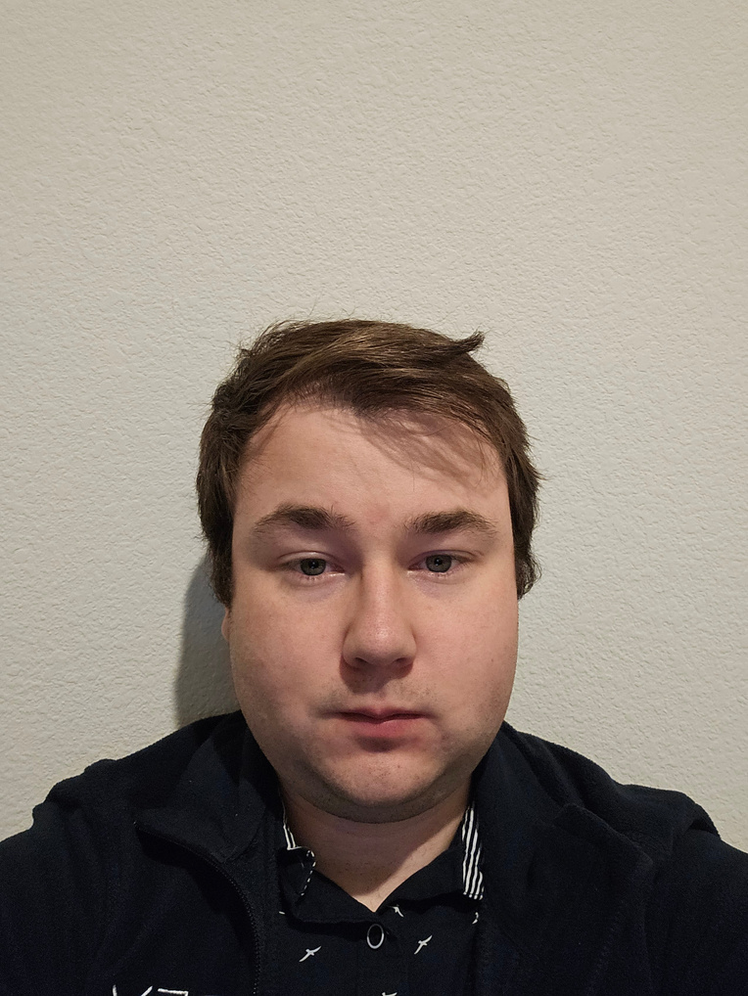
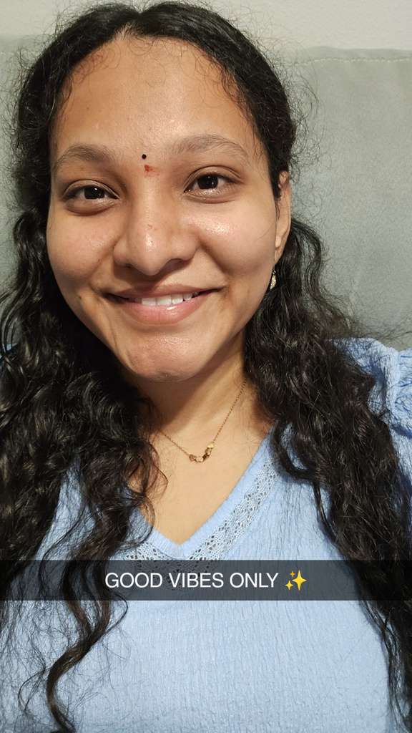
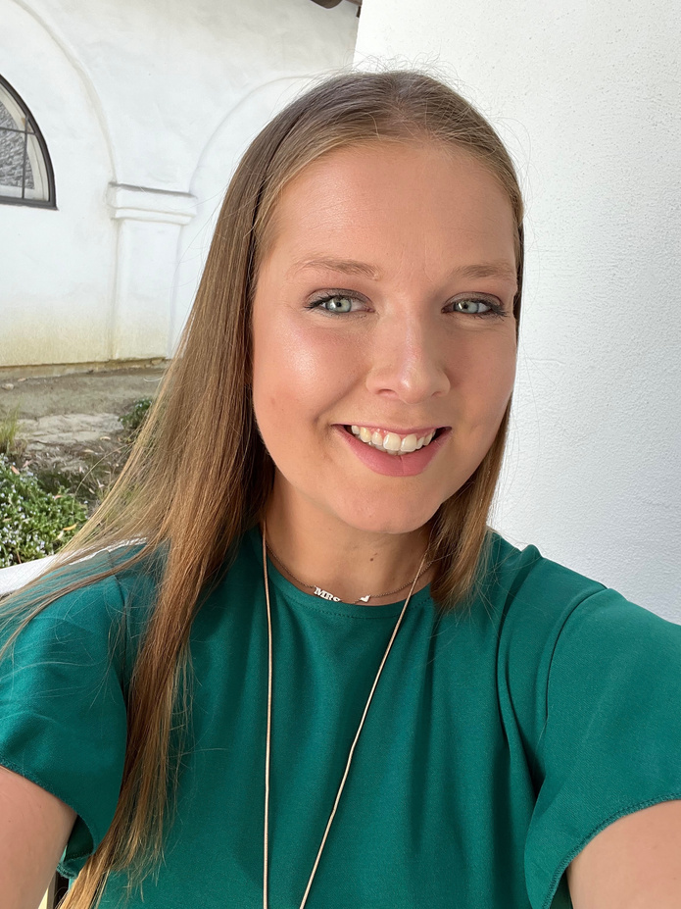
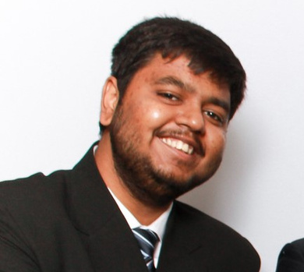


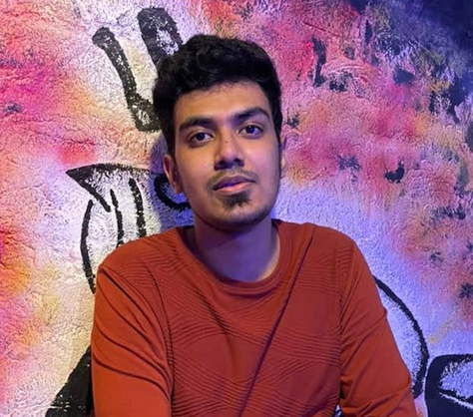
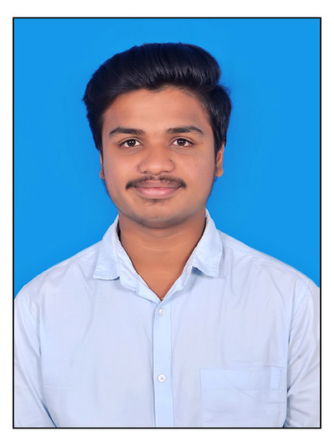
Faces of AlmaMingle & Their Roles
Andre Sharp
Kamalini Ponnuru
Madi McCauley
Rahman Mehmood
Documentation & Testing
Project Management & Testing
UI/UX Development
Design
Shashank Verma
Suhaibuddin Ahmed
Usama Bin Faheem
Varun Mahankali
Front End
Configuration & Requirements
Requirements
Back end & Deployment
ALMA
MINGLE 4

Slide 5
Team Member Responsibilities - Coding
Name | Contributions
Kamalini Ponnuru | Home Page, UI enhancements & Testing
Varun Mahankali | Messages Page & Back-end Apis & Deployment
Shashank Verma | Dashboards, Posts Screen, Donation Page
Rahman Mehmood | Events Page and Contact Us Page
Name | Contributions
Andre Sharp | Login Page, Testing, UI enhancements
Suhaibuddin Ahmed | Notifications Page & View Profile Page, Reported posts
Usama Bin Faheem | Events Page, Notifications Page, Inquiries page
Madison McCauley | UI enhancements, Signup page, Change Password
ALMA
MINGLE 5

Slide 6


Project
TIMELINE
and
PHASES
PHASE 1 | PHASE 2 | PHASE 3
Time taking | More strategic approach | Slight enhancements of previous work
Recalibrated our approach | Allocated work based on individual strengths | Feedback incorporation
Identified Strengths and weaknesses of team members | Continuous review of work | Deployment
ALMA
MINGLE 6

Slide 7
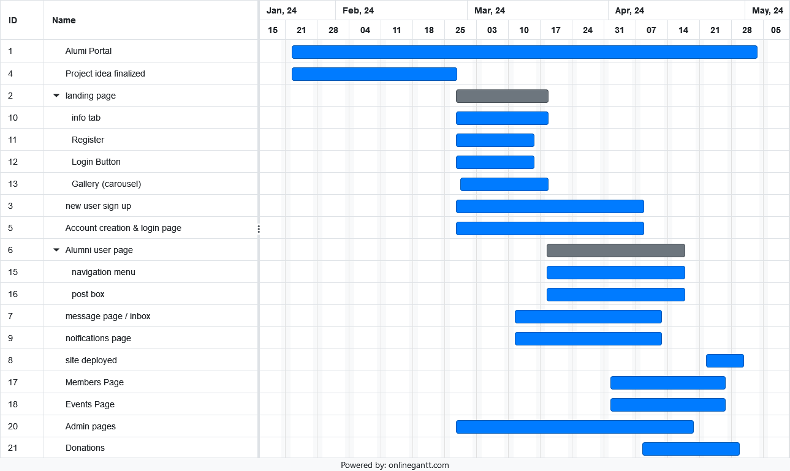
Project
TIMELINE
and
PHASES
ALMA
MINGLE 6

Slide 8
CORE FEATURES
Authentication
User Profiles
Content management features
Engagement: Events and donations
Admin User story

Slide 9
Authentication
Keeping Almamingle open only for university’s alumni
Almamingle only allows @my.unt.edu domains to register as a user
User Profiles
Community engagement platform required non ananymous users
User profile details allow for a deeper peer to peer interation between the users
ALMA
MINGLE

Slide 10
Content Management Features
Post Interactions
"Edit, delete, comment on, and report posts directly via options button."
Post Filtering & Broadcasting
"Filter posts by criteria and broadcast important updates to all users."
Admin Capabilities
"Comprehensive controls for user management and bulk post deletion."
ALMA
MINGLE

Slide 11
User Engagement Features
Event Management
Update or delete events via blue edit and red delete buttons. Edit through a dialogue box to save changes.
Event Ticket Booking
Book tickets through a blue button, entering the number of tickets and payment details in the booking dialogue.
Donations
Donate directly through the donations page, entering the amount and card details for processing.
ALMA
MINGLE

Slide 12
Admin User Story
Moderator of the platform
Manually allotted admin previliges to users
Similar UI
Admin Privileges
Post Broadcast
Reported Posts
Inquiries
Deleting anything posted
ALMA
MINGLE

Slide 13




FrontEnd Development
We have used React JS for our frontend development
BackEnd Development
Implementation details
We have used Node.js for our backend development.
Database
We have used MongoDB for this project.
Deployment
Deployed the whole project in vercel(frontend) and render(backend)

Slide 14


Frontend Implementation
Technology Used - ReactJS
There are several components that we have created in this project like Home, Posts, Header, Events, and many more. We have used Bootstrap, tailwind, and normal CSS for styling.
We have used ReactJS because it builds simple, fast, and scalable frontends of web applications.

Slide 15
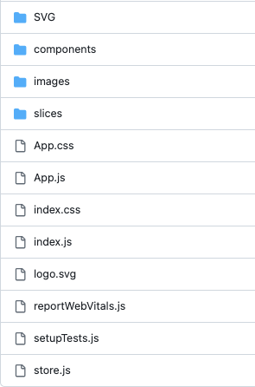
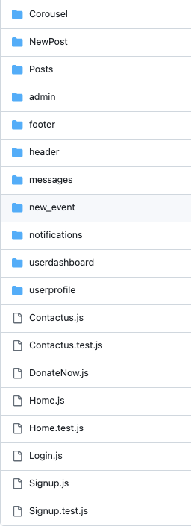
Project Structure Frontend
SRC folder
Components

Slide 16
Backend Implementation
Technology Used - NodeJS
We have used NodeJS as our backend because it is easy to integrate with ReactJS and it is a fast, reliable, and scalable technology. We have created several API such as get_events, Notification, messages, and many more.

Slide 17
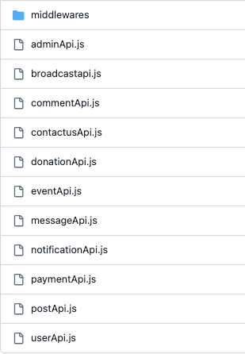
Project Structure Backend
These are all the API that we have created in
Node js each one of them will have API URL
associated with it which will be used in
frontend as API call
We have server.js file as well which contains all
configuration such as database configuration,
assign port number.
API

Slide 18
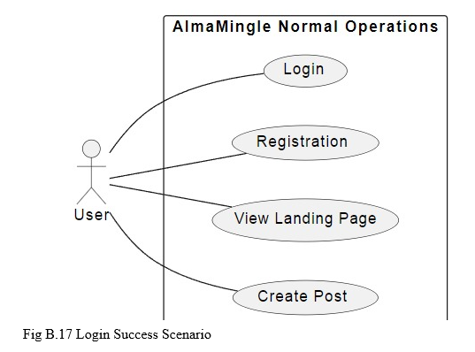
Testing - Unit & Functional Testing
Testing performed was mostly functional. Each component that was tested as it was developed in each phase of the project (Dashboard, Posting, Login signup etc.). Test suites were developed using jest framework and tested using VS code platform & planned around use case diagrams (pictured below).

Slide 19
Reflecting on Peer Review: Enhancements and Innovations
Feedback Recieved
From TECH EXPLORERS:
Concerns about message storage and functionality.
Queries on student verification processes.
Registration challenges for old students without UNT IDs.
From Tiny Coders:
Suggestions to enhance testing frameworks.
Issues with website accessibility on public networks.
Calls for improved user experience through messaging and notification features.
From TA Archana Goli:
Recommended including a Ticketing system for events.
Suggested adding a Donate feature to support the community.

Slide 20
Reflecting on Peer Review: Enhancements and Innovations
Action Taken
Message Storage and Functionality:
Selected a permanent storage solution; no auto-deletion of messages.
Student Verification:
Limited login to @my.unt.edu emails; exploring third-party authentication.
Testing Framework Enhancements:
Integrated Jest for robust backend testing.
Website Accessibility and Security:
Established a secure MongoDB connection; enhanced data validation on signup.
User Experience Improvements:
Added messaging and notifications; potential expansion to other universities.
New Features Implemented:
Event Ticketing: Simplified event management and registration.
Donate Feature: Enabled community support through donations.

Slide 21
Code Inspection
The code:
Engaged in discussions to enhance testing framework based on feedback.
Integrated Jest to extend testing
Feedback from "Tiny Coders" led to the evaluation of website
ensured data integrity and security.
Implemented rigorous data checks
Embraced iterative development
user-centric refinements
Moving forward:
Our project's journey emphasized adaptive development and robust testing to create a dynamic, effective communication and engagement platform.
Further development of the project would be fully developing this platform for other unversitys.

Slide 22
Limitations
Resource Constraints: Limited availability of hardware resources (memory, processing power) impacting scalability.
Scalability Challenges: Difficulty in handling increasing data volume or user traffic without performance degradation.
UX Limitations: Design choices impacting user satisfaction and adoption rates.
Geographical Limitations: Accessibility issues in remote areas with limited internet connectivity.
Budgetary Constraints: Financial limitations affecting technology investment like selecting the deployment platforms. We need to make sure the platform we select for deployment will not cost anything.

Slide 23
Link for Project Demo
Click here for the project demo video

Slide 24


Thank you!
ALMA MINGLE

